Slide 1
Java EE – Presentation Layer

Slide 2
Presentation Layer
Provision of services, display of information (e.g., in Windows or HTML, handling of user request (mouse clicks, keyboard hits), HTTP requests, command-line invocations, batch API)

Slide 3
Presentation layer patterns

Slide 4
Pattern categories mapped to layers
Model View Controller
Page Controller
Web Presentation Patterns
Session State Patterns
Data Transfer Object (DTO)
Presentation
Domain
Data Source
Domain Model
Service Layer
Distribution Patterns
Domain Logic
Patterns
Table Data Gateway
Offline Concurrency Patterns
Data Source Architectural Patterns
Object-Relational … Patterns
Notes:
De patterns in de gele blokjes gaan we actief gebruiken. Alleen kort opsommen voor een globale indruk van de studenten, later in detail bespreken als we per laag gaan realiseren.

Slide 5
Presentation Layer Patterns
Model View Controller
Page Controller
Front Controller
Template View
Transform View
Two Step View
Application Controller

Slide 6
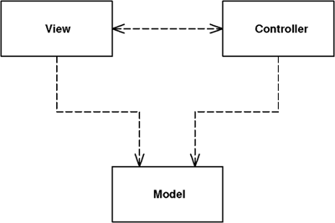
Model View Controller (MVC)
Splits user interface interaction into three distinct roles

Slide 7
Roles in MVC: Model
The model is an object that represents some information about the domain. It's a nonvisual object containing all the data and behavior other than that used for the UI. In its most pure OO form the model is an object within a Domain Model

Slide 8
Roles in MVC: View
The view represents the display of the model in the UI. Thus, if our model is a customer object our view might be a frame full of UI widgets or an HTML page rendered with information from the model. The view is only about display of information; any changes to the information are handled by the third member of the MVC trinity: the controller.

Slide 9
Roles in MVC: Controller
The controller takes user input, manipulates the model, and causes the view to update appropriately. In this way UI is a combination of the view and the controller.

Slide 10
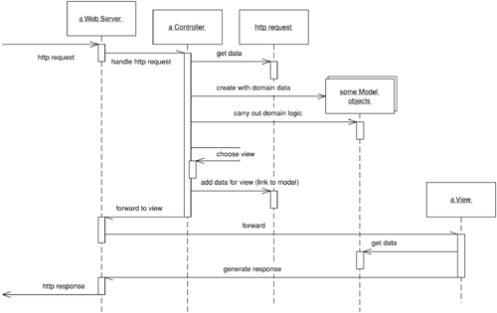
MVC roles working together

Slide 11
Page Controller
An object that handles a request for a specific page or action on a Web site.
The basic idea behind a Page Controller is to have one module on the Web server act as the controller for each page on the Web site.
The basic responsibilities of a Page Controller are:
Decode the URL and extract any form data to figure out all the data for the action.
Create and invoke any model objects to process the data. All relevant data from the HTML request should be passed to the model so that the model objects don't need any connection to the HTML request.
Determine which view should display the result page and forward the model information to it.

Slide 12
Page Controller
Sounds like a normal controller in MVC right?
A more precise thought is that you have a Page Controller for each action, where an action is a button or link.
Differs from the idea that every view has always exactly one controller.

Slide 13
JSP and Servlet
Implementing Presentation Layer Patterns in Java EE

Slide 14
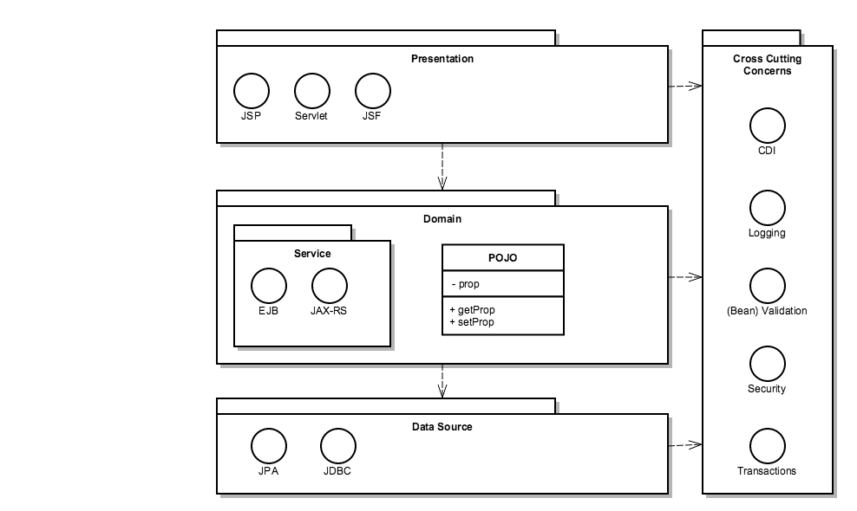
Java EE Platform architecture

Slide 15
Servlets vs JSP
Servlet
Java code mixed with markup
Useful as a view (with little HTML) or controller
JSP
Markup mixed with Java code
Useful as a view (with much HTML)
Both can be described and configured in the web.xml or using annotations

Slide 16
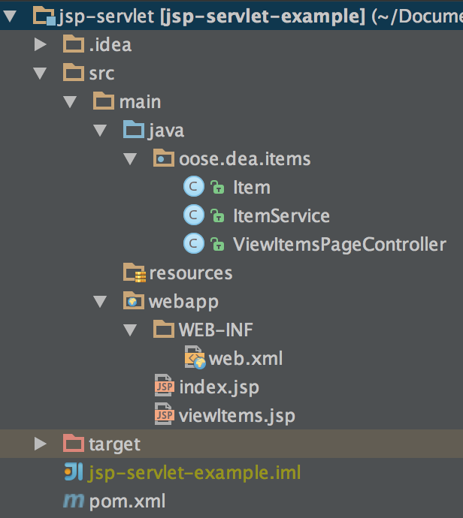
Structure of a web-app in the IDE

Slide 17
Structure of a web-app in the IDE
Standard Maven Structure for Source files

Slide 18
Structure of a web-app in the IDE
Servlets are just Java code.

Slide 19
Structure of a web-app in the IDE
Web.xml in webapp/WEB-INF

Slide 20
Structure of a web-app in the IDE
JSPs in webapp. Also base folder for HTML, CSS, JS, etc.

Slide 21
Structure of a web-app in the IDE
Maven pom.xml. Includes:
<dependency> <groupId>javax</groupId> <artifactId>javaee-api</artifactId> <version>7.0</version> </dependency>

Slide 22
Deployment descriptor (web.xml)
Instructs the container how to deal with this application
<?xml version="1.0" encoding="UTF-8"?>
<web-app xmlns="http://java.sun.com/xml/ns/javaee"
xmlns:xsi="http://www.w3.org/2001/XMLSchema-instance"
xsi:schemaLocation="http://java.sun.com/xml/ns/javaee http://java.sun.com/xml/ns/javaee/web-app_3_0.xsd"
version="3.0">
<welcome-file-list>
<welcome-file>index.html</welcome-file>
</welcome-file-list>
</web-app>

Slide 23
Deployment descriptor (web.xml)
In Servlet API version 3.0 most components of web.xml are replaced by annotations that go directly to Java source code.
We will see examples later

Slide 24
Servlet example
public class HelloServlet extends HttpServlet {
@Override
protected void doGet(HttpServletRequest req, HttpServletResponse resp)
throws ServletException, IOException {
PrintWriter writer = resp.getWriter();
writer.println("<html><head><title>Hello</title></head><body>");
writer.println("<p>Hello World!</p>");
writer.println("<p>Current time: " + new Date() + "</p>");
writer.println("</body></html>");
}
}

Slide 25
Servlet Mapping
Before Servlet 3.0 in web.xml
<servlet>
<servlet-name>hello</servlet-name>
<servlet-class>example.HelloServlet</servlet-class>
</servlet>
<servlet-mapping>
<servlet-name>hello</servlet-name>
<url-pattern>/hello</url-pattern>
</servlet-mapping>

Slide 26
Servlet Mapping
In Servlet 3.0 via annotation
@WebServlet("/hello")
public class HelloServlet extends HttpServlet {
...

Slide 27
HttpServletRequest - Attribute
Contains request information
Also can be used to store attributes
request.setAttribute(“key", value);
request.getAttribute(“key”);

Slide 28
HttpServletRequest: Parameter
request.getParameterNames();
Enumeration<String>
String value = request.getParameter("name");

Slide 29
HttpServletResponse: content
response.getWriter().println("...");
Write text
response.getOutputStream().write(...);
Write binary

Slide 30
Problem with servlets
Writing HTML in Java is hideous
PrintWriter writer = resp.getWriter();
writer.println("<html><head><title>Hello</title></head><body>");
writer.println("<p>Hello World!</p>");
writer.println("<p>Current time: " + new Date() + "</p>");
writer.println("</body></html>");

Slide 31
Java Server Pages (JSP)
Write HTML
standard markup language
Add dynamic scripting elements
Add Java code

Slide 32
JSP example
WEB-INF/jsp/hello.jsp
<%@page import="java.util.Date"%>
<html>
<head><title>Hello</title></head>
<body>
<p>Hello World!</p>
<p>Current time: <%= new Date() %></p>
</body>
</html>

Slide 33
JSP mapping
In web.xml
<servlet>
<servlet-name>hello2</servlet-name>
<jsp-file>/WEB-INF/jsp/hello.jsp</jsp-file>
</servlet>
<servlet-mapping>
<servlet-name>hello2</servlet-name>
<url-pattern>/hello2</url-pattern>
</servlet-mapping>

Slide 34
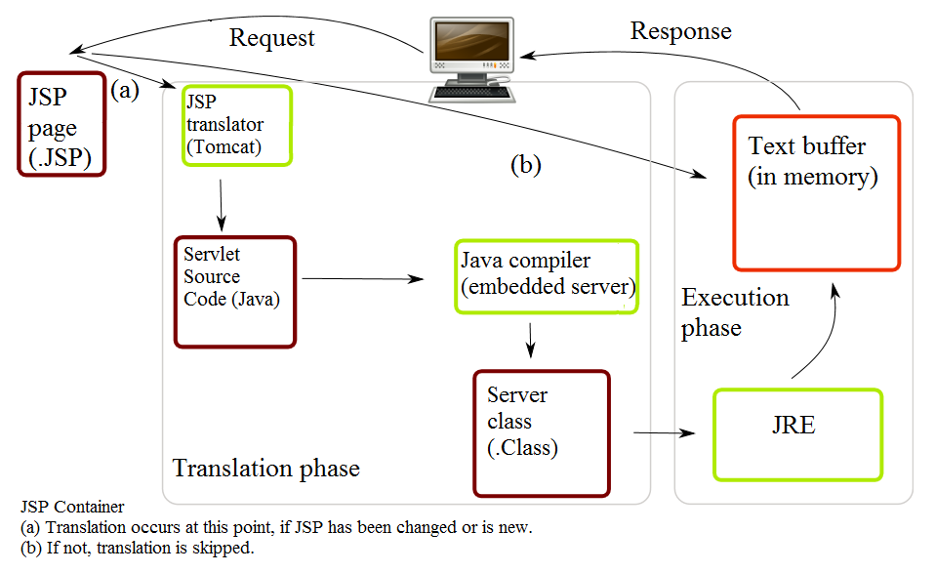
JSP in fact are servlets in disguise

Slide 35
Dynamic content
Expression
<p>Current time: <%= new Date() %></p>
Scriptlet
<p>Current time: <% out.println(new Date()); %></p>

Slide 36
Dynamic content
Declaration
<%!
private Date currentDate(){
return new Date();
}
%>
<p>Current time: <%= currentDate() %></p>

Slide 37
JSP properties
request – HttpServletRequest
response – HttpServletResponse
out – Writer
session – HttpSession
application – ServletContext
pageContext – PageContext

Slide 38
Expression Language (EL)
Easy way to access JavaBeans in different scopes

Slide 39
Basic Operators in EL
Operator | Description
. | Access a bean property or Map entry
[] | Access an array or List element
( ) | Group a subexpression to change the evaluation order
+ | Addition
- | Subtraction or negation of a value
* | Multiplication
/ or div | Division
% or mod | Modulo (remainder)
== or eq | Test for equality
!= or ne | Test for inequality
< or lt | Test for less than
> or gt | Test for greater than
<= or le | Test for less than or equal
>= or gt | Test for greater than or equal
&& or and | Test for logical AND
|| or or | Test for logical OR
! or not | Unary Boolean complement
empty | Test for empty variable values

Slide 40
JavaBeans
Public default constructor
public class Person {
private String name;
public Person() {}
public String getName() {
return name;
}
public void setName(String name) {
this.name = name;
}
}
getX and setX methods
for each property X

Slide 41
JavaBeans in EL can serve as Model
Person person = new Person();
person.setName("Roman");
request.setAttribute("person", person);
<p>Person: ${person.name}</p>

Slide 42
Java Standard Tag Library (JSTL)
Set of standard tools for JSP
<%
List<String> lectors = Arrays.asList("Siim", "Roman", "Margus");
pageContext.setAttribute("lectors", lectors);
%>
<c:set var="guestLector" value="Margus" />
<c:forEach var="lector" items="${lectors}">
Name: ${lector}
<c:if test="${lector eq guestLector}“>(guest)</c:if>
<br />
</c:forEach>

Slide 43
Problem with JSP
Writing Java in JSP is hideous
<p>Current time: <%= currentDate() %></p>

Slide 44
Page Controller implementation

Slide 45
Servlet controller, JSP view
protected void doGet(HttpServletRequest req, HttpServletResponse resp) throws ServletException, IOException {
req.setAttribute("currentDate", new Date());
req.getRequestDispatcher("/WEB-INF/jsp/hello.jsp").forward(req, resp);
}
Model data

Slide 46
Servlet controller, JSP view
protected void doGet(HttpServletRequest req, HttpServletResponse resp) throws ServletException, IOException {
req.setAttribute("currentDate", new Date());
req.getRequestDispatcher("/WEB-INF/jsp/hello.jsp").forward(req, resp);
}
Select and invoke view

Slide 47
Servlet controller, JSP view
WEB-INF/jsp/hello.jsp
<html>
...
<body>
<p>Current time: ${currentDate}</p>
</body>
</html>
View uses the
data from model

Slide 48
Filters and Listeners

Slide 49
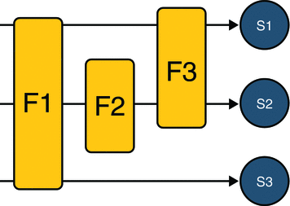
Filters
Allows you to do something before, after or instead of servlet invocation.
Filter chain
Notes:
F: Filter
S: Servlet

Slide 50
Filter example
public class LoggingFilter implements Filter {
public void doFilter(ServletRequest request, ServletResponse response, FilterChain chain) throws IOException, ServletException {
long start = System.currentTimeMillis();
chain.doFilter(request, response);
long end = System.currentTimeMillis();
System.out.println("Time spent: " + (end - start));
}
}

Slide 51
Filter example
public class LoggingFilter implements Filter {
public void doFilter(ServletRequest request, ServletResponse response, FilterChain chain) throws IOException, ServletException {
long start = System.currentTimeMillis();
chain.doFilter(request, response);
long end = System.currentTimeMillis();
System.out.println("Time spent: " + (end - start));
}
}
Invoke next filter in
chain or the servlet
if this was the last filter

Slide 52
Filter declaration
Before Servlet 3.0 in web.xml
<filter>
<filter-name>loggingFilter</filter-name>
<filter-class>example.LoggingFilter</filter-class>
</filter>
<filter-mapping>
<filter-name>hello</filter-name>
<url-pattern>/*</url-pattern>
</filter-mapping>

Slide 53
Filter declaration
We’re going to use a filter later on to implement dependency inection using Guice
In Servlet 3.0 via annotation
@WebFilter("/*")
public class LoggingFilter implements Filter {
...

Slide 54
Life cycle event listeners
javax.servlet.ServletContextListener
javax.servlet.ServletContextAttributeListener
javax.servlet.ServletRequestListener
javax.servlet.ServletRequestAttributeListener
javax.servlet.http.HttpSessionListener
javax.servlet.http.HttpSessionAttributeListener

Slide 55
Listener example
We’re going to use a filter later on to implement dependency inection using Guice
public class LoggingRequestListener implements ServletRequestListener {
@Override
public void requestInitialized(ServletRequestEvent event) {
System.out.println("Received request from " + event.getServletRequest().getRemoteAddr());
}
@Override
public void requestDestroyed(ServletRequestEvent event) {}
}

Slide 56
Listener declaration
Before Servlet 3.0 in web.xml
<listener>
<listener-class>
example.LoggingRequestListener
</listener-class>
</listener>

Slide 57
Listener declaration
In Servlet 3.0 via annotation
@WebListener
public class LoggingRequestListener implements ServletRequestListener {
...

Slide 58
Should I bother?
There are a lot of fancy Java web frameworks that simplify application building.
Should I still learn these basic technologies, will I ever use them?

Slide 59
Should I bother?
You are still going to deploy your application to a web container.
Most traditional frameworks use JSP as the view technology.

Slide 60
What about servlets?
Most frameworks are based on the Servlet API
You will probably still encounter things like HttpSession, HttpServletRequest etc inside your code.
You might want to write filters and listeners.
You probably won’t write much servlets. But sometimes they can still be handy for simple tasks.

